Slide 1
Divvy Data Analysis
CBDS Dev-Up Capstone
Jack Mann

Slide 2
Top 5 Stations

Slide 3
Trip Duration by User Type

Slide 4
Most Popular Trips

Slide 5
Performance by Age

Slide 6
Performance by Gender

Slide 7
Busiest Bikes in Chicago

Slide 8
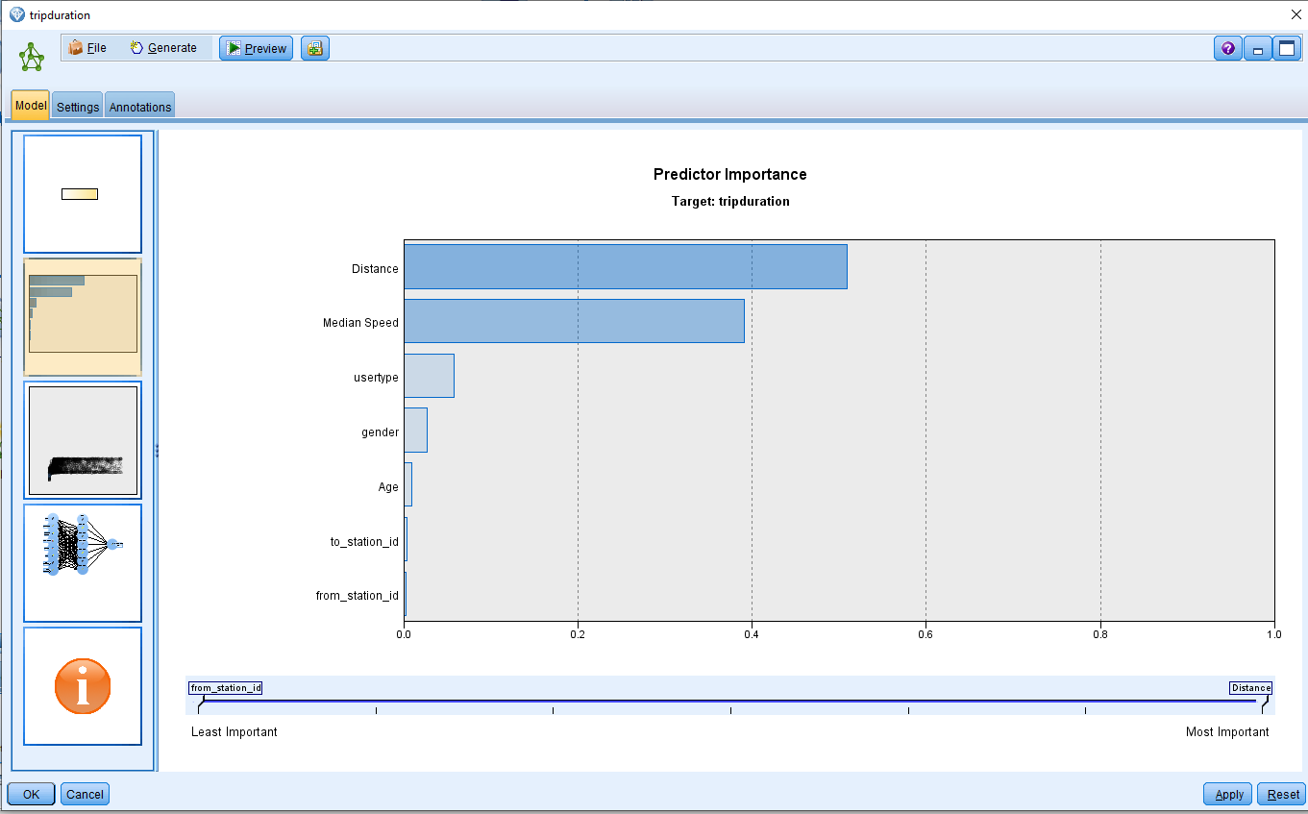
Models – Neural Network

Slide 9
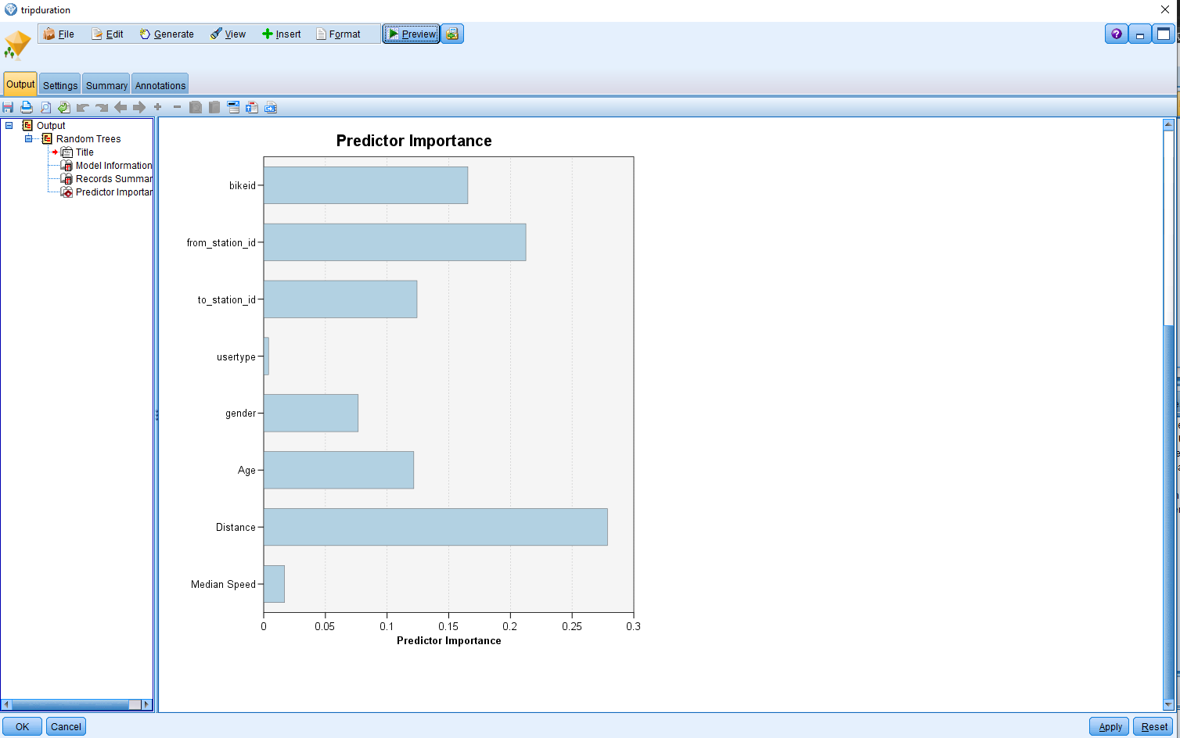
Models – Random Trees

Slide 10
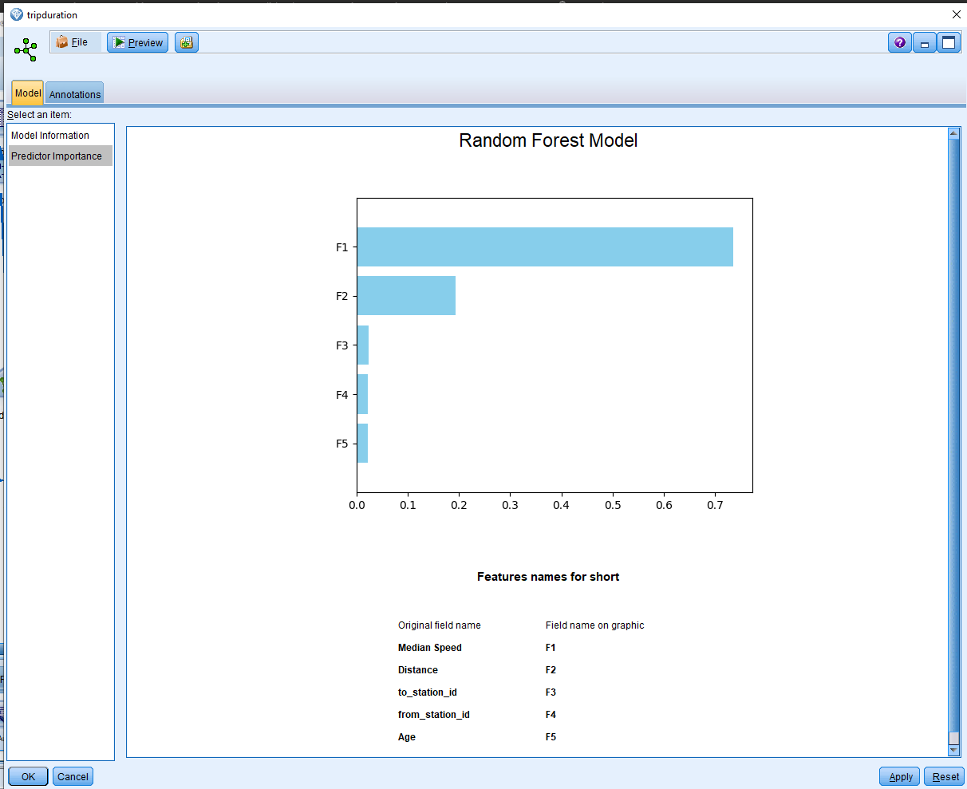
Models – Random Forest

Slide 11
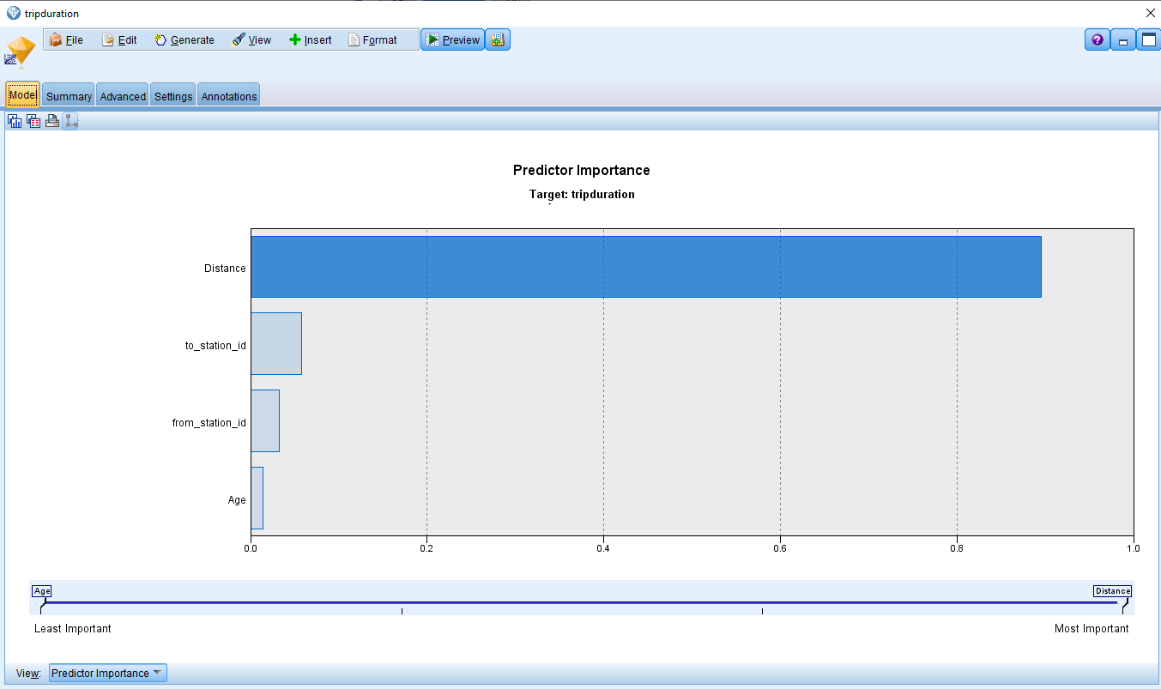
Models – Linear Regression

Slide 12
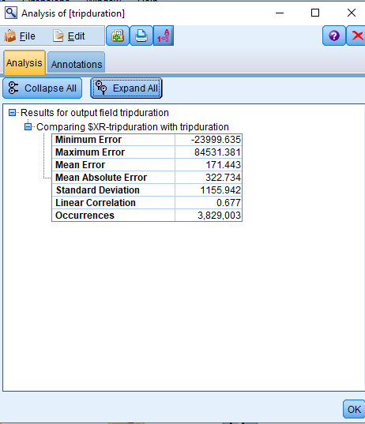
Ensembled Analysis
Bearing in mind that all these values are in seconds, we can see a large spread in the minimum and maximum error.
Mean error is approximately 3 minutes of miscalculation and the standard deviation is 3 hours long.
With a linear correlation of 0.677, we can say that this ensemble provides 67% accuracy; further training and configuration is required to make a more accurate model.

Slide 13
Erratum
Data cleansing could be improved during the preparation phase (Python)
The author merged the files successfully (maintaining the original record count during the join step), but ultimately let the statistical algorithms handle incomplete entries
The data could have been improved using a .dropna() step to remove null values.
Data visualization could be improved
The author opted to use Excel to make all charts in the interest of speed.
Visualization could be improved by using more meaningful chart types and by leveraging Python’s matplotlib library for visualization.
Models could be improved; the ensemble had an accuracy of 67%
Due to the time required to perform an ensemble, the author was unable to properly experiment with multiple variables to affect the target ‘tripduration.’
Better variable selection and model configuration would have made for more accurate models.
The slides have no text
This was intended to simulate an oral presentation. With better modelling and more confident data, the author could add insightful commentary.
The NLP part of the project was skipped
The author accepts full responsibility for NLP being excluded.

